Slide 1

Stress Detection

Slide 2
Background

Slide 3
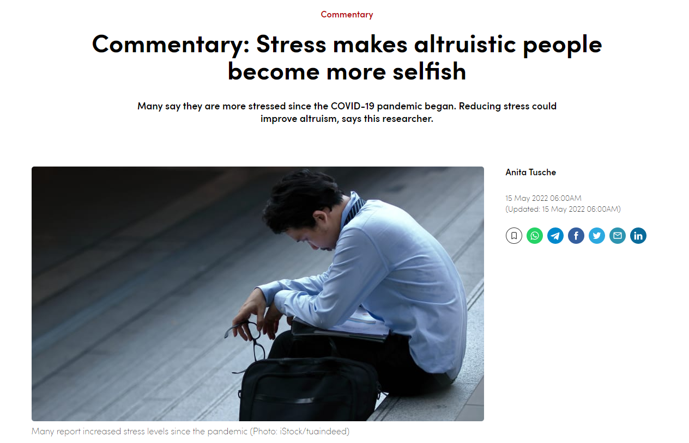

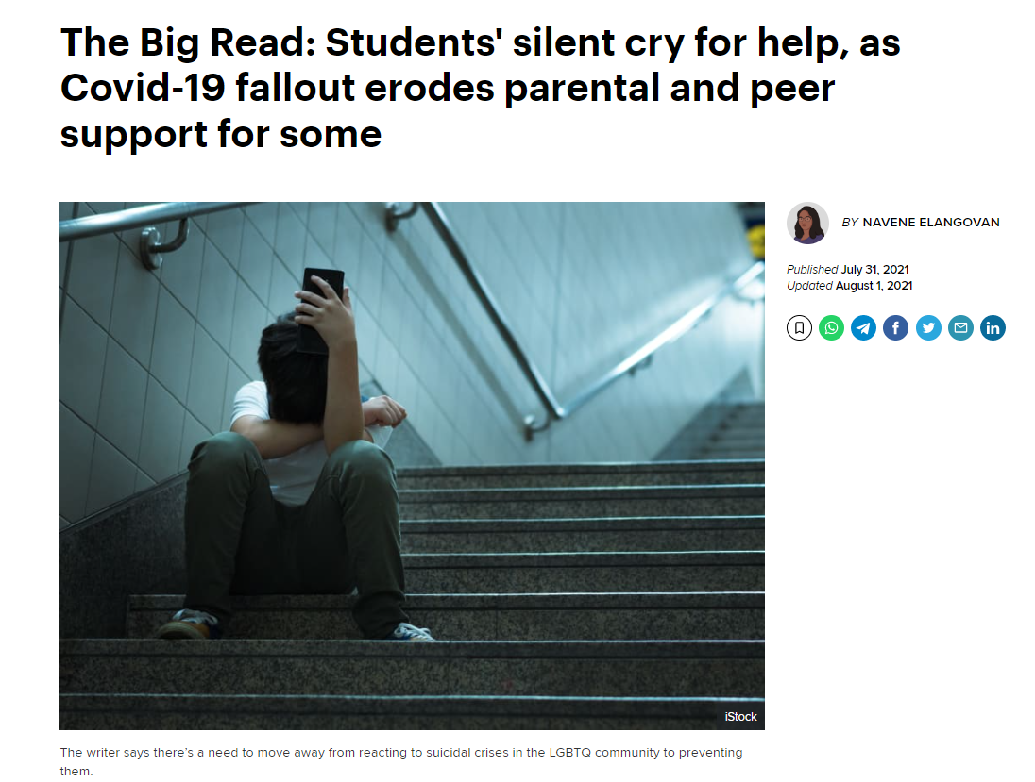
The issue of mental health among school students in Singapore has been thrown into the spotlight following the tragic incident at River Valley High School recently, where a 13-year-old student was allegedly killed by a 16-year-old classmate.
Police investigations revealed that the older teenager — who has been charged with murder — had previously attempted suicide in 2019 and was a patient at the Institute of Mental Health (IMH).

Slide 4
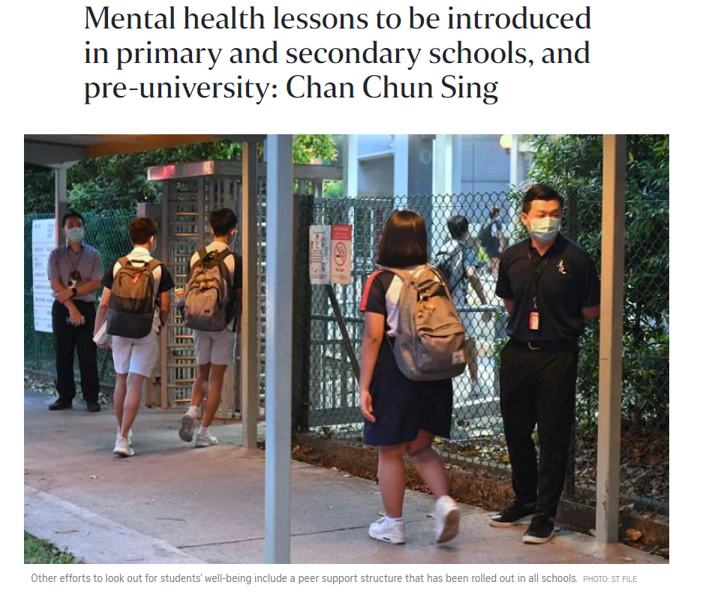


Slide 5
References
https://www.channelnewsasia.com/commentary/phd-students-mental-health-crisis-stress-anxiety-depression-2429881
https://www.channelnewsasia.com/commentary/stress-impact-altruism-more-selfish-brain-2683391
https://www.todayonline.com/big-read/big-read-students-silent-cry-help-covid-19-fallout-erodes-parental-and-peer-support-some
https://www.straitstimes.com/singapore/parenting-education/students-mental-health-always-been-a-priority-says-chan-chun-sing-in
https://www.channelnewsasia.com/cna-insider/mental-health-what-schools-doing-help-students-2655911

Slide 6
Problems

Slide 7

Problems
Lack of access/Lack of information
Lack of self awareness/Under-diagnosed
Negative stigma
Expensive

Slide 8
Goals

Slide 9

Goals
Make mental healthcare more accessible
Build resilience
Raise Community Awareness
Make mental healthcare more affordable

Slide 10
Project Introduction

Slide 11
Project Introduction
To recap,
Make mental healthcare more affordable
Raise Community Awareness
Make mental healthcare more accessible
Build resilience
Online chat room
Connect with user via text message/call
Collect data for future analysis
Target audience
Students
Working adults

Slide 12


Project Introduction
Identify mental health status
Measure stress scale

Slide 13
Answer the questions
To predict whether the individual needs treatment based on certain factors
-> classifier
Age, gender, country, race, family history
Work remotely?, company benefits
Attitudes towards mental health
Identify mental health status

Slide 14
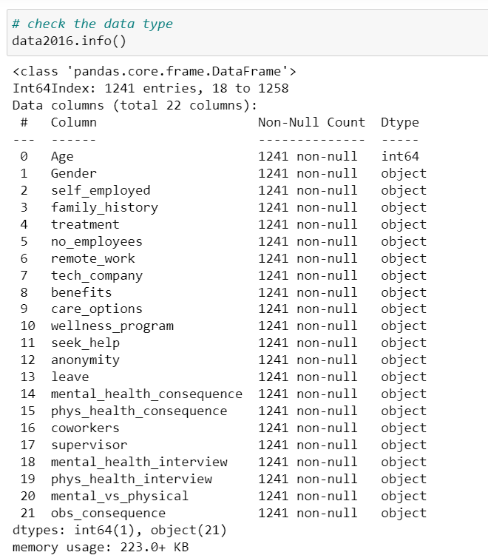
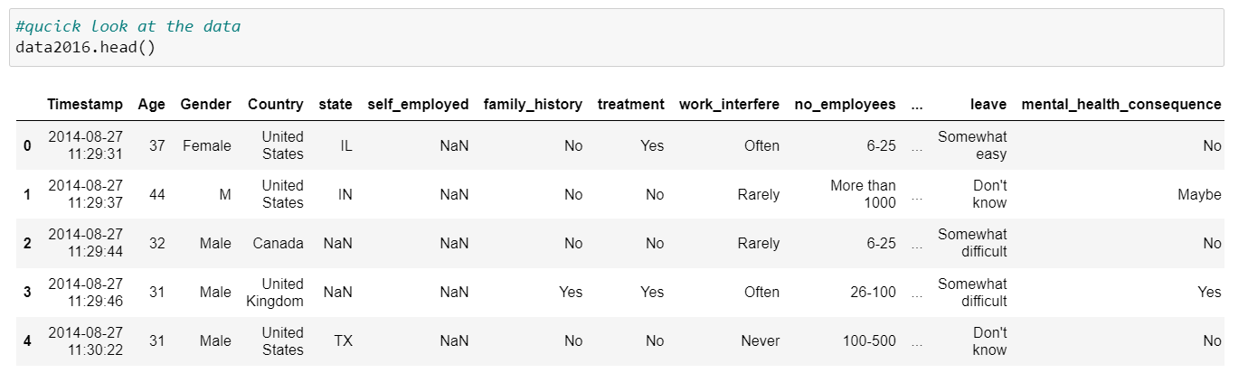
Data
Source: OSMI Mental Health in Tech Survey
Data: 1259 rows; 27columns

Slide 15
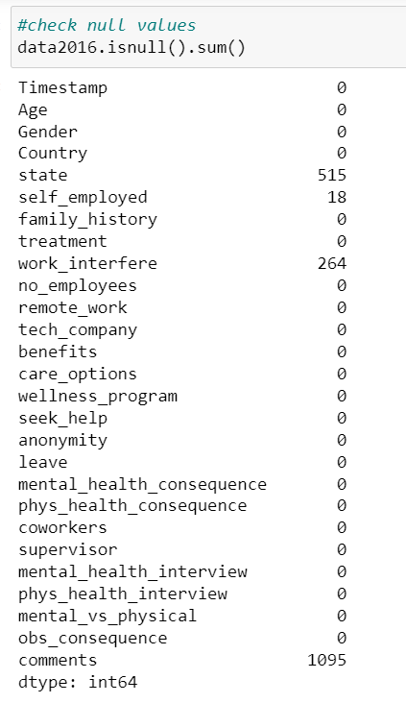
Data Pre-processing
Clean null value
Drop meaningless column, timestamp, comment
Convert continuous data to integer
Convert categorical data to dummy variables

Slide 16
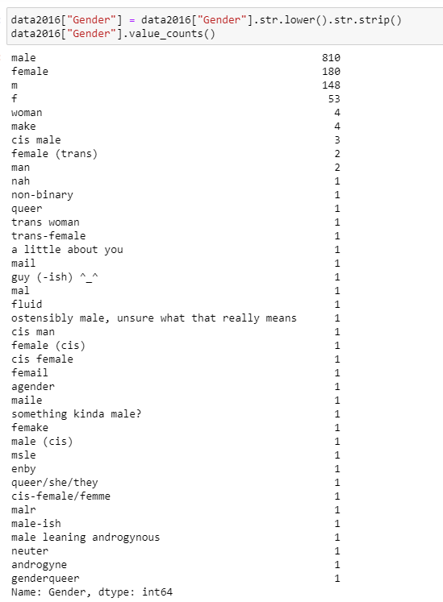
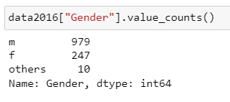
Example 1

Slide 17
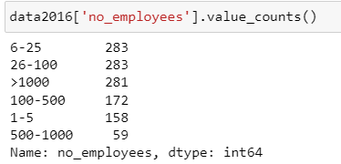
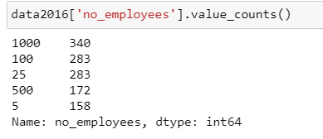
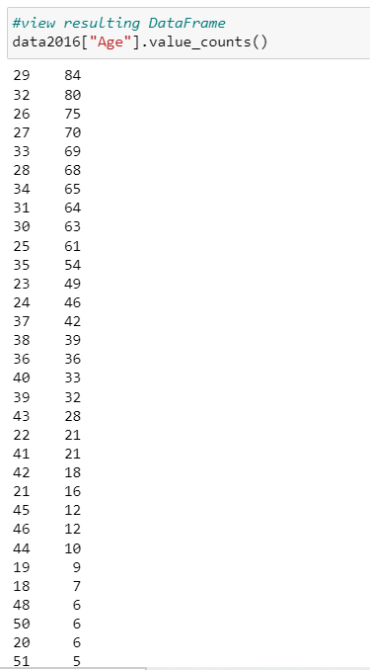
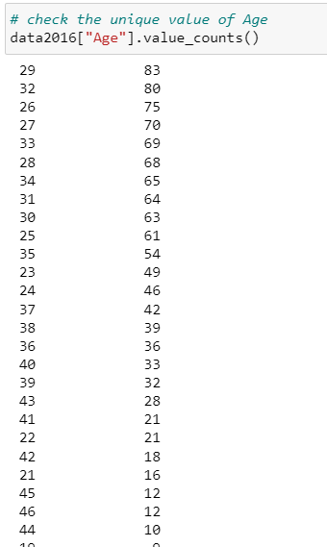
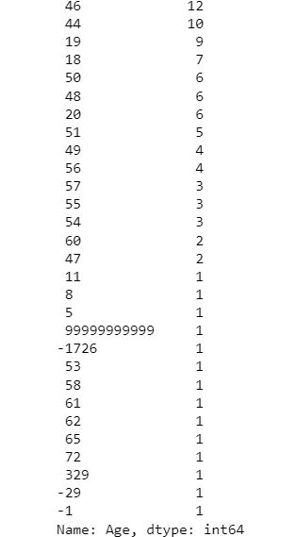
Example 2
Example 3

Slide 18
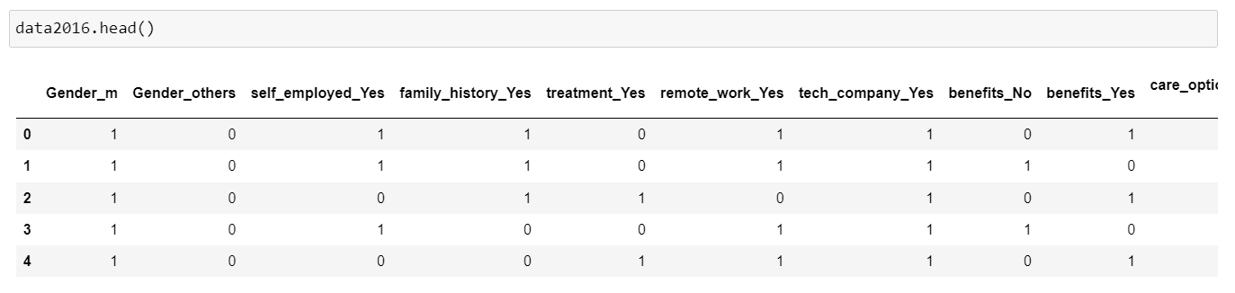

Slide 19
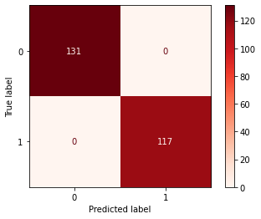
Evaluation
Model: Logistic Regression
Specificity = 1
Accuracy = 1

Slide 20
Tell your story
To predict the stress level based on words
-> NLP, classifier
NLP: To understand, interpret and manipulate human language
Classifier: To measure stress scale
Measure stress scale

Slide 21
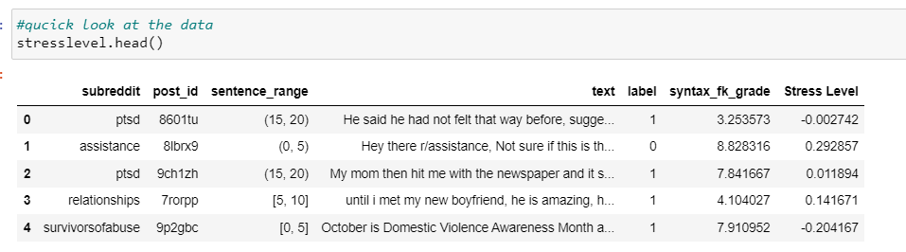
Data
Source: Reddit
Data: 2838 rows; 7columns

Slide 22
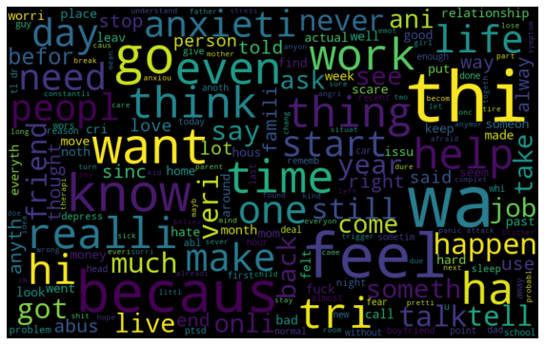
Data pre-processing
Convert to lover case
Remove special characters
Tokenizing
Lemmatizing/Stemming
Stop word removal

Slide 23
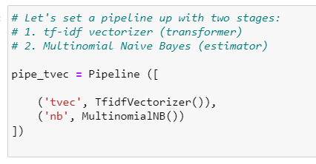
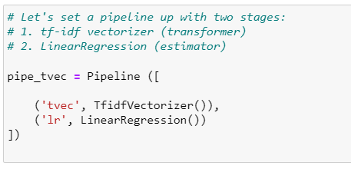
(a) classify the text, stress-1, non stress-0
(b) predict stress scale

Slide 24

Improvement
Word embedding technique
Recognize face emotion

